Slide 1
Angles Scavenger Hunt
By Theresa, Dilkaran, Simran, Rajbir,

Slide 2
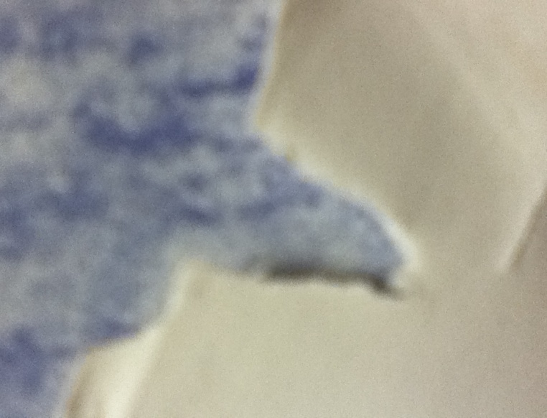
Acute angle
The acute angle is smaller than 90 degrees. Our picture is a part of someone’s snowflake.

Slide 3
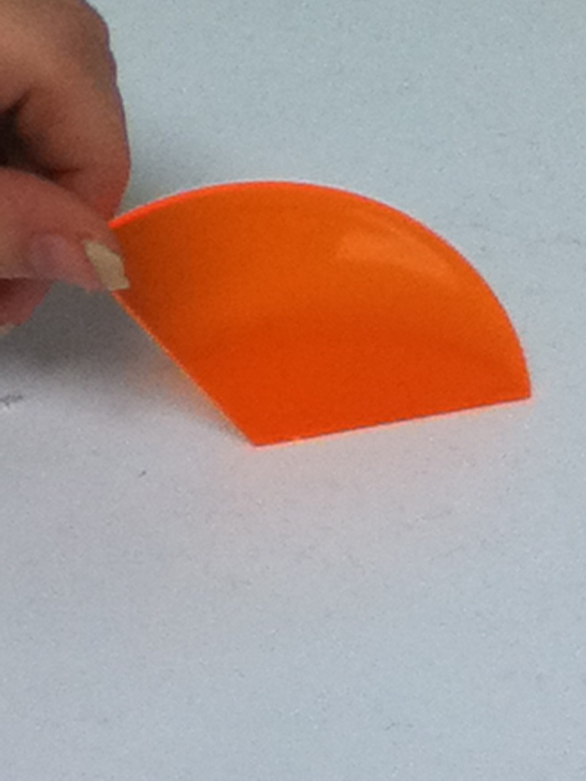
Obtuse Angle
An obtuse angle is bigger then 90 degrees. Our picture is a block.

Slide 4
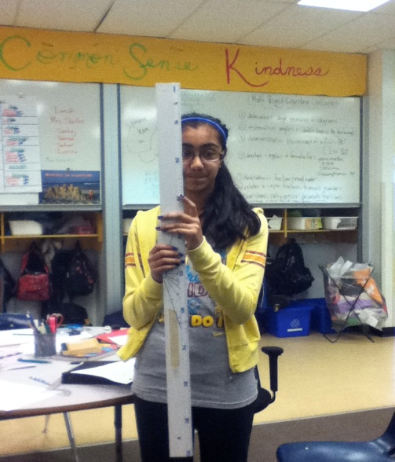
Straight Angle
A straight angle is 180 degrees. Our picture is Simran and a ruler. Or in other words a straight line this picture is of Simran holding a 180 degrees.

Slide 5
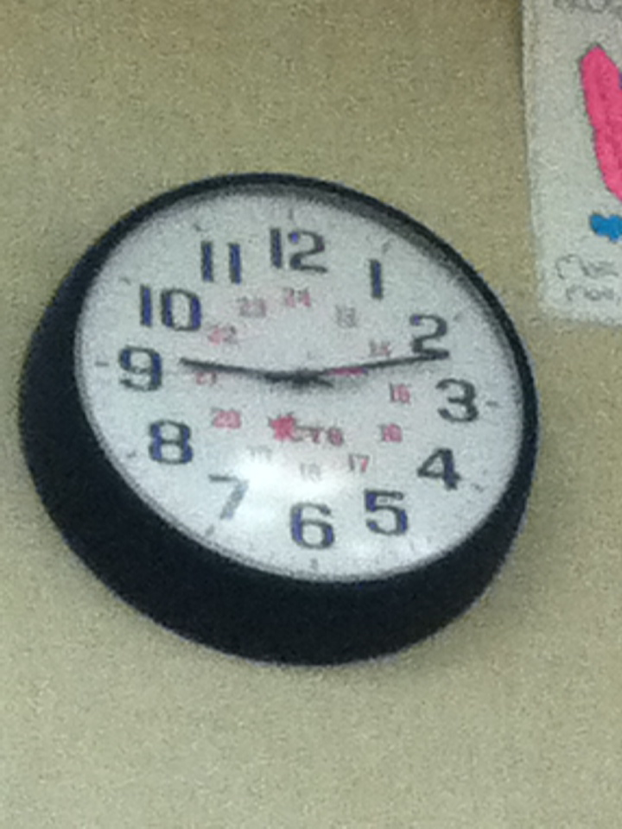
360 circle
360 is the same as a circle and a square
Our picture is a clock in our classroom

Slide 6
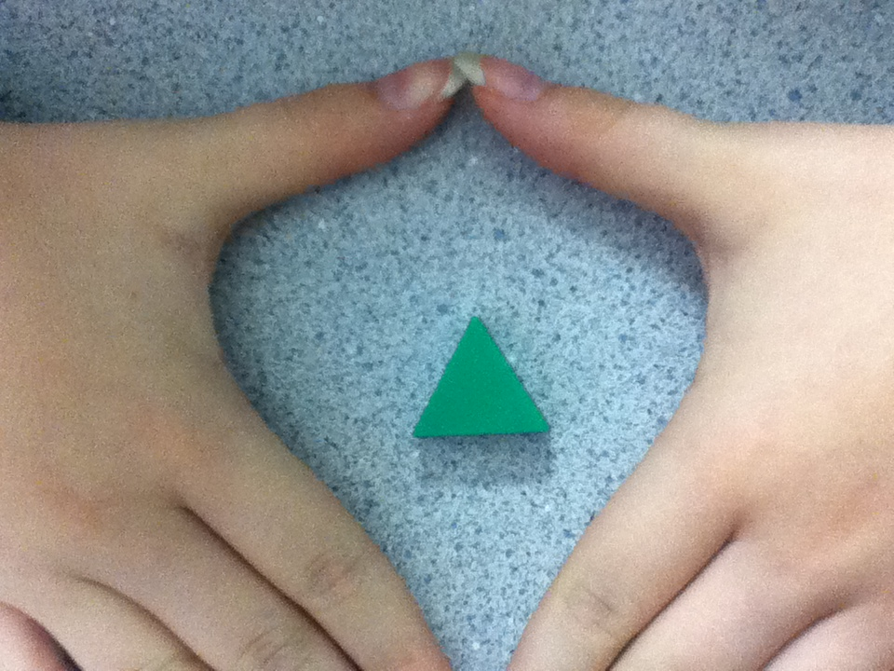
Triangle 180
A triange is 180 dregrees
Our picture is a triangle block in the bins

Slide 7
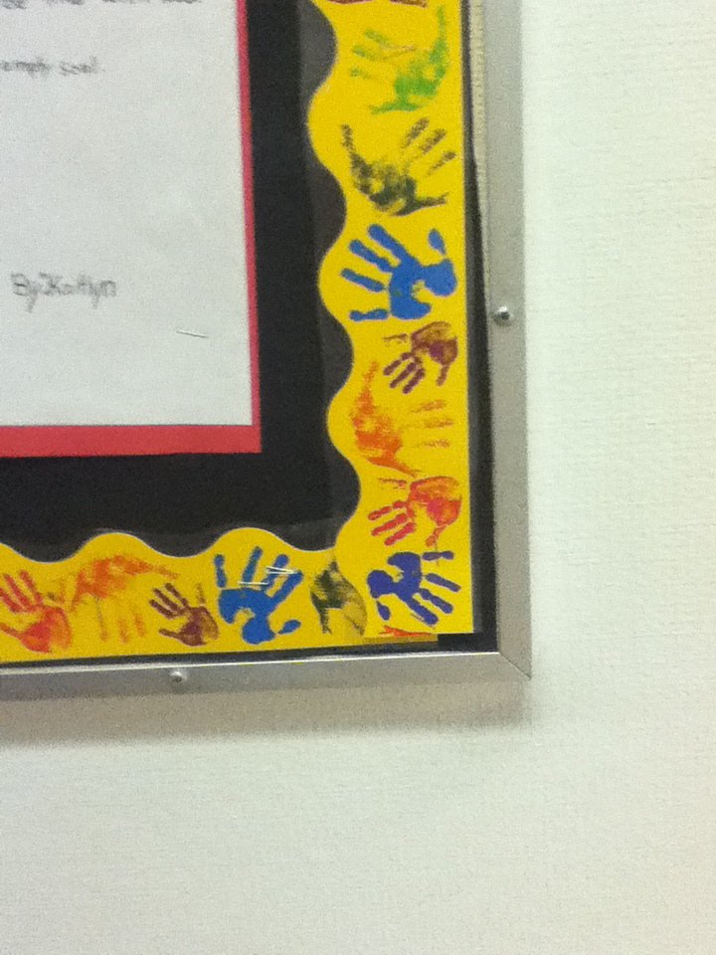
Right Angle
A right angle is exactly 90 degrees. Our picture is the corner of a bulletin board and a door

Slide 8
Reflex Angle degrees.
A reflex angle is an angle that is 180-360 degrees.
Our picture is the hands of a clock.

Slide 9
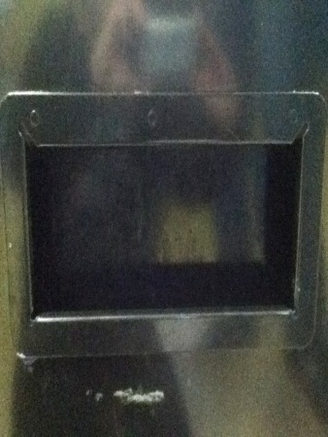
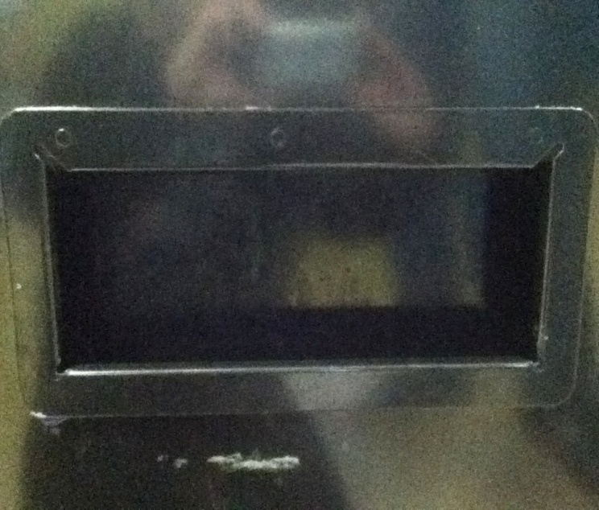
Square and Rectangle
A square and a rectangle is the same. They are both 360 degrees. For our pictures we did the slots on the milk machine

Slide 10
Angles
REVIEW
Acute angles
Obtuse angles
Reflex
Straight
Right

